Slide 1
Integrated Coastal Zone Management
Unit 3: Understanding integrated coastal zone management

Slide 2
Introduction
Unit content
Identifying aspects of integration
Classifying coastal threats and issues
Case study: mining impact in coastal areas
Learning outcomes
Upon completion of this unit, students will be able to
Understand the implications of an ‘integrated’ approach to coastal management
Recognise how coastal threats can be grouped and analysed
Be able to understand the coastal impacts associated with mining and their relevance to ICZM

Slide 3
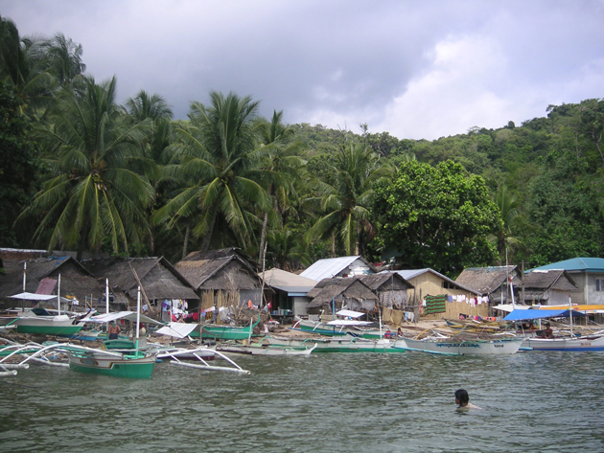
Introduction
Managing coastal resources means managing across user groups
- integrating their needs and those of the natural environment

Slide 4
Integration
‘Integration’
- bringing together, mixing together, combining, creating something new...
‘Integrating’ in coastal zone management
- combining interests and aiming to satisfy different needs
‘Traditional’ approach would manage rivers, wetlands, dunes separately
Integrated approach would manage the links between these to ensure activities in one place do not have negative impacts elsewhere

Slide 5
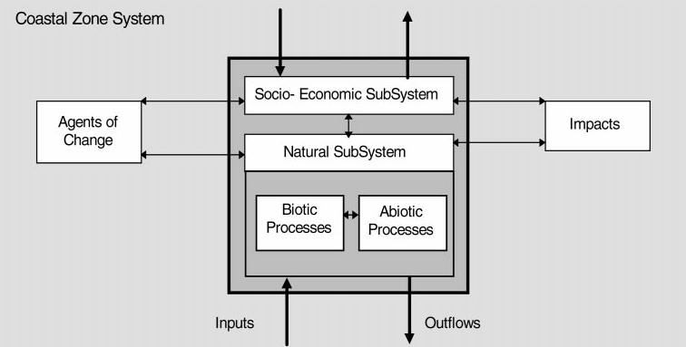
Integration
‘Integration’
- bringing together, mixing together, combining, creating something new...
Human activities
Natural environment
Integrated approach reflects the close links between human activities, the natural environment and the impacts of human activities in the coastal zone

Slide 6
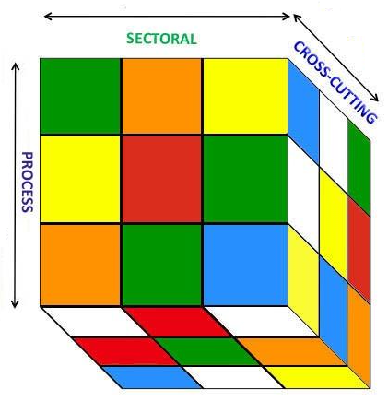
Integration
‘Integration’
- bringing together, mixing together, combining, creating something new...
‘Horizontal integration’
- manages across sectors and seeks common problems
- seeks to avoid giving one sector preference over another
Example: fishing and tourism
- many areas of conflict
- manage through combining interests where possible
- minimising conflict through spatial planning and other means

Slide 7
Integration
‘Integration’
- bringing together, mixing together, combining, creating something new...
‘Vertical integration’
- managing across levels of government
- centre, province, district, village...
- ensuring links between policies and practice are present
Refer image on previous slide
Improves administration
Less conflict between levels of government
Similar policies adopted across country
Greater effectiveness of government
Better public relations!

Slide 8
Integration
‘Integration’
- bringing together, mixing together, combining, creating something new...
‘Spatial integration’
managing across administrative boundaries
managing across physical boundaries (land, sea, river)
reflects nature of environmental processes and human impacts
Refer image on previous slide
‘Scientific integration’
trans-disciplinary approach (combining disciplines to form new approaches)
integration of ‘traditional’ and ‘scientific’ knowledge
difficult but generates widespread benefits

Slide 9
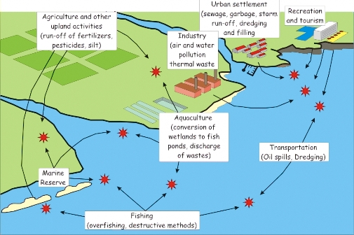
Integration
‘Integration’
- an approach which reflects the unique nature of the coast and human impacts

Slide 10
Coastal threats
‘Threats’
- what are the most important threats facing the coast?
Can these be grouped into broad ‘issues’?
Biodiversity loss
Pollution
Coastal erosion
Climate change

Slide 11
Coastal threats
Threats are associated with human activities
- individual activities can present multiple threats at different scales
Mining and its threats
What coastal threats do we associate with mining?
Do these arise from mining itself or related activities?
Do they occur close to the mine?
Do they occur at the same time?

Slide 12
Conclusion
ICZM – an approach which reflects the physical nature of the coast and human impacts
Dimensions of ICZM
Horizontal
Vertical
Spatial
Scientific
Need to know which human activities are associated with which impacts for effective coastal zone management

